Slide 1

NAME: AJAYI PHILIP OLUWADARA
MATRIC NO: AUL/SCI/20/00546
TOPIC: ANALYTICAL FUNCTIONS AND ANALYTICAL FUNCTIONS AS MAPPINGS.

Slide 2
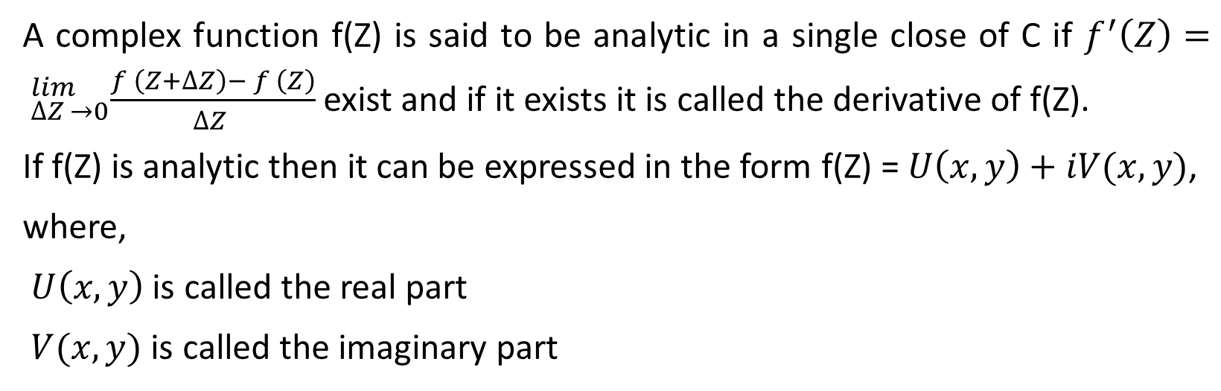
ANALYTICAL FUNCTIONS
A complex function f(Z) is said to be analytic in a single close of C if $f^{′}\left(Z\right)= _{∆Z →0}^{lim}\frac{f^{ }\left(Z+∆Z\right)− f^{ }\left(Z\right)}{∆Z }$ exist and if it exists it is called the derivative of f(Z).
If f(Z) is analytic then it can be expressed in the form f(Z) = $U\left(x,y\right)+iV(x,y)$,
where,
$U\left(x,y\right)$ is called the real part
$V(x,y)$ is called the imaginary part

Slide 3

EXAMPLES
Express each of this in form of $U\left(x,y\right)+iV(x,y)$
f(Z) = $e^{Z}$
f(Z) = $Z^{2}$
SOLUTION
f(Z) = $e^{Z}$
Z = x + iy
$e^{Z}$ = $e^{x+iy}$ = $e^{x}$ . $e^{iy}$
$e^{iy}$ = cos y + i siny
F = $e^{x}(cos y + i siny)$ = $e^{x}cos y$ + ${i e}^{x}siny$
F = u + iv
U = $e^{x}cos y$ , v = $e^{x}siny$

Slide 4

2. f(Z) = $Z^{2}$
Z = x + iy
$Z^{2}$ = ${(x + iy) }^{2}$ = $x^{2}+xyi+xyi− y^{2}$
= $\left(x^{2}− y^{2}\right)+i 2xy$
U = $\left(x^{2}− y^{2}\right)$
V = $2xy$

Slide 5
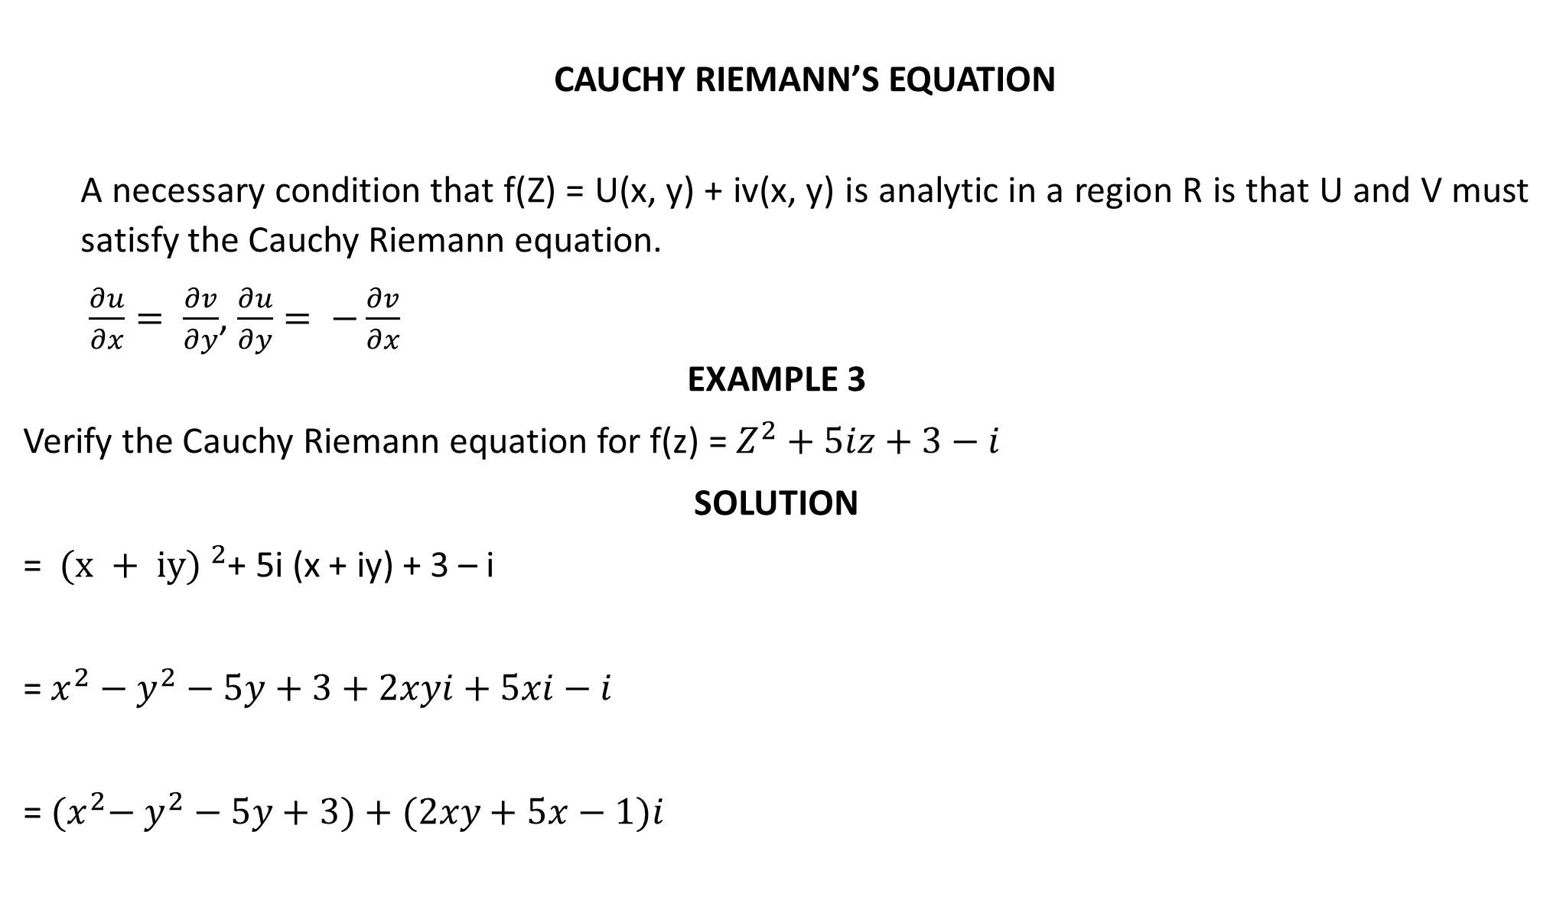
CAUCHY RIEMANN’S EQUATION
A necessary condition that f(Z) = U(x, y) + iv(x, y) is analytic in a region R is that U and V must satisfy the Cauchy Riemann equation.
$\frac{∂u}{∂x}= \frac{∂v}{∂y}$, $\frac{∂u}{∂y}= −\frac{∂v}{∂x}$
EXAMPLE 3
Verify the Cauchy Riemann equation for f(z) = $Z^{2}+5iz+3−i$
SOLUTION
= ${(x + iy) }^{2}$+ 5i (x + iy) + 3 – i
= $x^{2}−$ $y^{2}−5y+3+2xyi+5xi−i$
= ${(x}^{2}−$ $y^{2}−5y+3)+(2xy+5x−1)i$

Slide 6

U = ${(x}^{2}−$ $y^{2}−5y+3)$
V = $(2xy+5x−1)$
$\frac{∂u}{∂x}=$ 2x, $\frac{∂v}{∂y}=2x$
$\frac{∂u}{∂x}= \frac{∂v}{∂y}$
$\frac{∂u}{∂y}=$ -2y – 5, $\frac{∂v}{∂x}=2y+5$
$−\frac{∂v}{∂x}$ = - 2y – 5
$\frac{∂u}{∂y}= −\frac{∂v}{∂x}$

Slide 7

EXAMPLE 4
Check if f(z) = ${}_{Z}^{−}$satisfies the Cauchy Riemann equation
SOLUTION
Z = x + iy
${}_{Z}^{−}$ = x – iy = x + i(-y)
F = x + i(-y)
F = u + iv
U = x, V = - y
$\frac{∂u}{∂x}=1, \frac{∂u}{∂y}=0, \frac{∂v}{∂x}=0, \frac{∂v}{∂y}= −1$
$\frac{∂u}{∂x}≠ \frac{∂v}{∂y}$

Slide 8
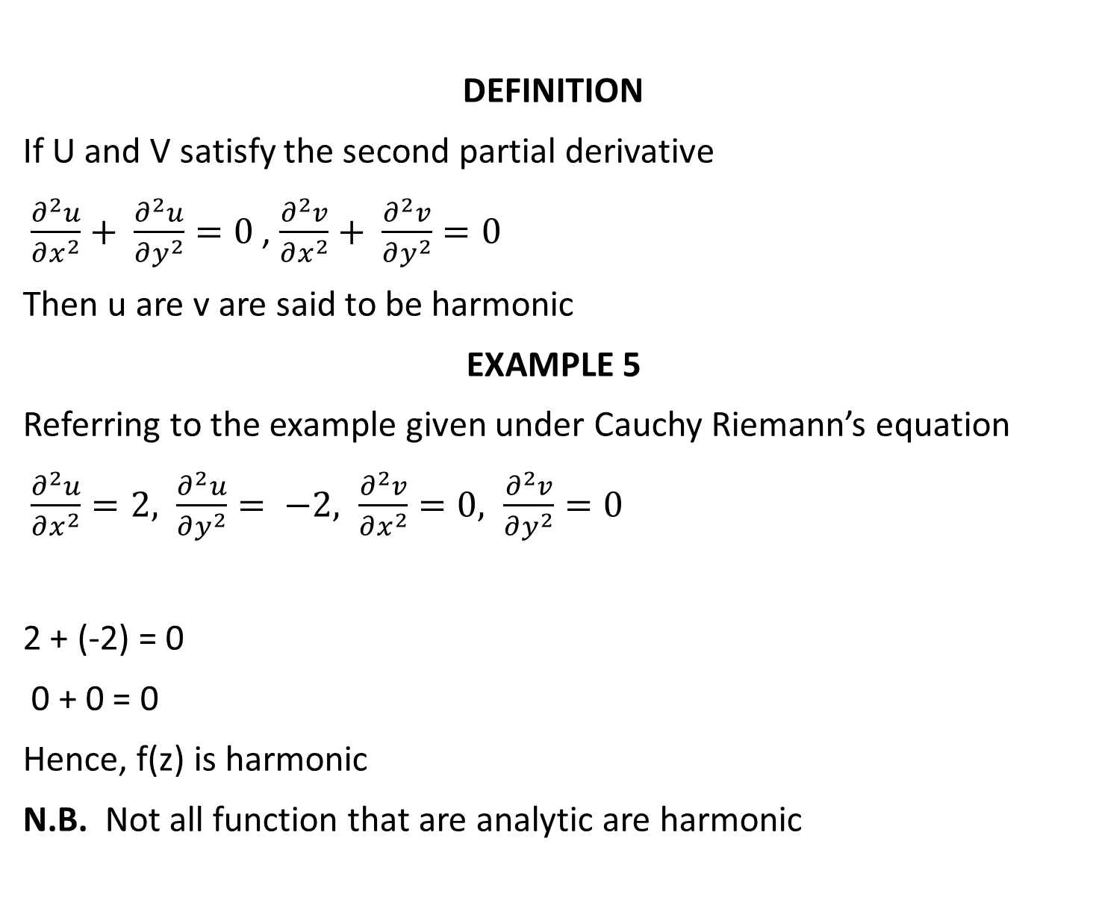
DEFINITION
If U and V satisfy the second partial derivative
$\frac{∂^{2}u}{∂x^{2}}+ \frac{∂^{2}u}{∂y^{2}}=0$ , $\frac{∂^{2}v}{∂x^{2}}+ \frac{∂^{2}v}{∂y^{2}}=0$
Then u are v are said to be harmonic
EXAMPLE 5
Referring to the example given under Cauchy Riemann’s equation
$\frac{∂^{2}u}{∂x^{2}}=2, \frac{∂^{2}u}{∂y^{2}}= −2, \frac{∂^{2}v}{∂x^{2}}=0, \frac{∂^{2}v}{∂y^{2}}=0$
2 + (-2) = 0
0 + 0 = 0
Hence, f(z) is harmonic
N.B. Not all function that are analytic are harmonic

Slide 9
ANALYTICAL FUNCTIONS AS MAPPINGS
In complex analysis, analytic functions play a fundamental role. An analytic function, also known as a holomorphic function, is a complex-valued function that is defined and differentiable at every point within its domain. The key property of analytic functions is that they can be locally approximated by power series expansions, which makes them highly tractable and allows for various techniques to be employed in their study.
From a geometric perspective, we can view analytic functions as mappings between complex planes. Let's consider a function f(z) defined on a domain D in the complex plane. Every point in the domain D corresponds to a unique complex number z, and the function f(z) maps these complex numbers to other complex numbers in the complex plane.

Slide 10
Cont’d
For example, let's consider the function f(z) = z^2. This function takes any complex number z and squares it. Geometrically, this means that each point z in the complex plane is mapped to the point z^2. If we consider a specific point, say z = 1 + i, then f(1 + i) = (1 + i)^2 = 1 + 2i - 1 = 2i. So, the point 1 + i is mapped to the point 2i under this function.
Similarly, we can consider the function f(z) = e^z, where e is the base of the natural logarithm. This function takes any complex number z and raises e to the power of that number. Geometrically, this means that each point z in the complex plane is mapped to the point e^z. For example, if we take z = i (the imaginary unit), then f(i) = e^i, which is a point on the unit circle in the complex plane.

Slide 11
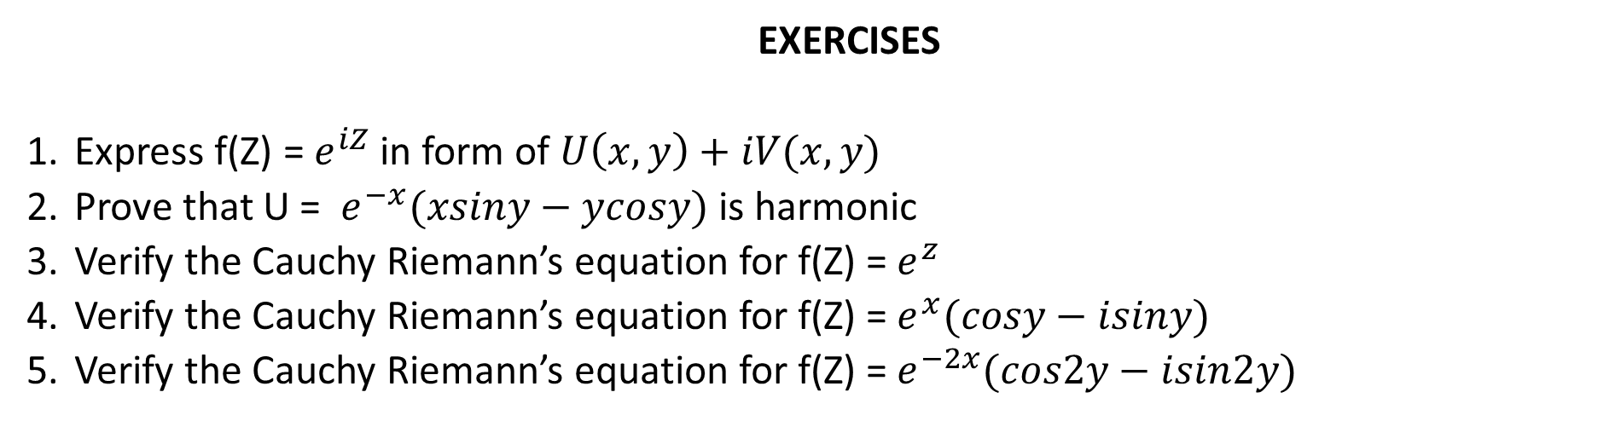
Cont’d
Analytic functions exhibit many interesting properties, such as the preservation of angles and conformal mapping properties. They are extensively used in various areas of mathematics, physics, and engineering due to their rich structure and applications.
EXERCISES
Express f(Z) = $e^{iZ}$ in form of $U\left(x,y\right)+iV(x,y)$
Prove that U = $e^{−x}(xsiny−ycosy)$ is harmonic
Verify the Cauchy Riemann’s equation for f(Z) = $e^{z}$
Verify the Cauchy Riemann’s equation for f(Z) = $e^{x}(cosy−isiny)$
Verify the Cauchy Riemann’s equation for f(Z) = $e^{−2x}(cos2y−isin2y)$

